Slide 1
CHAPTER SIX
Internet Protocol (IP) and IP Addressing

Slide 2
Internet Protocol (IP)
The Internet Protocol (IP) is a protocol used for communicating data across a packet-switched internetwork using the Internet Protocol Suite, also referred to as TCP/IP.
IP is the primary protocol in the Internet Layer of the Internet Protocol Suite and has the task of delivering distinguished protocol datagrams (packets) from the source host to the destination host solely based on their addresses.
Notes:
Internet Protocol suite (IP suite) is the standard network model and communication protocol stack used on the Internet and on most other computer networks. While other networking models exist, the IP suite is overwhelmingly the global standard for computer-to-computer communication

Slide 3
Internet Protocol (IP) continued
For this purpose the Internet Protocol defines addressing methods and structures for datagram encapsulation.
The first major version of addressing structure, now referred to as Internet Protocol Version 4 (IPv4) is still the dominant protocol of the Internet, although the successor, Internet Protocol Version 6 (IPv6), is being deployed actively worldwide (128 bits).
Communication at the network layer is host-to-host (computer-to-computer); a computer somewhere in the world needs to communicate with another computer somewhere else in the world.

Slide 4
Internet Protocol (IP) continued
Usually, computers communicate through the Internet.
The packet transmitted by the sending computer may pass through several LANs or WANs before reaching the destination computer.
For this level of communication, we need a global addressing scheme; we use the term IP address to mean a logical address in the network layer of the TCP/IP protocol suite.

Slide 5
IPv4 Addresses
An IPv4 address is a 32-bit address that uniquely and universally defines the connection of a device (for example, a computer or a router) to the Internet.
IPv4 addresses are unique and universal.
They are unique in the sense that each address defines one, and only one, connection to the Internet.
Two devices on the Internet can never have the same address at the same time.

Slide 6
Address Space
A protocol such as IPv4 that defines addresses has an address space.
An address space is the total number of addresses used by the protocol.
If a protocol uses N bits to define an address, the address space is 2^{N} because each bit can have two different values (0 or 1) and N bits can have 2^{N} values.

Slide 7
Address Space continued
IPv4 uses 32-bit addresses, which means that the address space is 2³² or 4,294,967,296 (more than 4 billion).
This means that, theoretically, if there were no restrictions, more than 4 billion devices could be connected to the Internet.
We will see shortly that the actual number is much less because of the restrictions imposed on the addresses.

Slide 8
IP Address Notations
There are two prevalent notations to show an 1Pv4 address: binary notation and dotted-decimal notation.
Binary Notation
In binary notation, the IPv4 address is displayed as 32 bits.
Each octet is often referred to as a byte.
So it is common to hear an IPv4 address referred to as a 32-bit address or a 4-byte address.

Slide 9
IP Address Notations continued
The following is an example of an IPv4 address in binary notation:
01110101 10010101 00011101 00000010
2. Dotted-Decimal Notation
To make the IPv4 address more compact and easier to read,
Internet addresses are usually written in decimal form with a decimal point (dot) separating the bytes.
The following is the dotted-decimal notation of the above address: 117.149.29.2

Slide 10
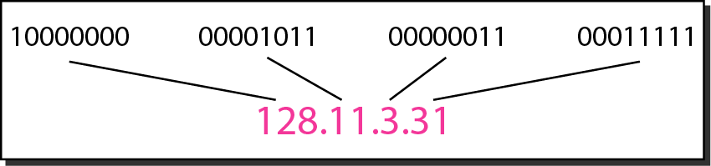
IP Address Notations continued
Example:
Dotted-decimal notation and binary notation for an IPv4 address

Slide 11
Example 1
Change the following IPv4 addresses from binary notation to dotted-decimal notation.
Solution
We replace each group of 8 bits with its equivalent decimal number and add dots for separation.

Slide 12
Example 2
Change the following IPv4 addresses from dotted-decimal notation to binary notation.
Solution
We replace each decimal number with its binary equivalent.

Slide 13
Example 3
Find the error, if any, in the following IPv4 addresses.
Solution
a. There must be no leading zero (045).
b. There can be no more than four numbers.
c. Each number needs to be less than or equal to 255.
d. A mixture of binary notation and dotted-decimal notation is not allowed.

Slide 14
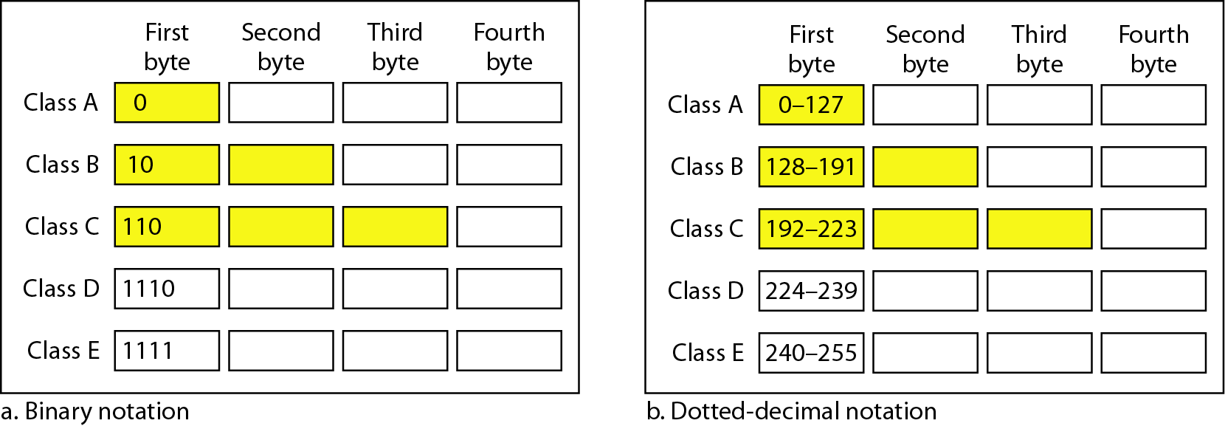
Classful Addressing
IPv4 addressing, at its inception, used the concept of classes.
This architecture is called classful addressing.
In classful addressing, the address space is divided into five classes: A, B, C, D, and E.
Each class occupies some part of the address space.

Slide 15
Example 4
Find the class of each address.
a. 00000001 00001011 00001011 11101111
b. 11000001 10000011 00011011 11111111
c. 14.23.120.8
d. 252.5.15.111
Solution
a. The first bit is 0. This is a class A address.
b. The first 2 bits are 1; the third bit is 0. This is a class C address.
c. The first byte is 14; the class is A.
d. The first byte is 252; the class is E.

Slide 16
Classes and Blocks
One problem with classful addressing is that each class is divided into a fixed number of blocks with each block having a fixed size
Number of Blocks for class A = 2⁷
Number of Blocks for class B = 2¹⁴
Number of Blocks for class C = 2²¹
Block size for class A = 2²⁴
Block size for class B = 2¹⁶
Block size for class C = 2⁸
Notes:
Unicast and Multicast are two methods for sending data over a network.
Unicast is a one-to-one communication model in which a single sender delivers data to a single receiver
multicast is a one-to-many communication model in which ,a single sender provides data to several recipients.

Slide 17
Classes and Blocks continued
Previously, when an organization requested a block of addresses, it was granted one in class A, B, or C.
Class A addresses were designed for large organizations with a large number of attached hosts or routers.
Class B addresses were designed for midsize organizations with tens of thousands of attached hosts or routers.
Class C addresses were designed for small organizations with a small number of attached hosts or routers.

Slide 18
Classes and Blocks continued
A block in class A address is too large for almost any organization.
This means most of the addresses in class A were wasted and were not used.
A block in class B is also very large, probably too large for many of the organizations that received a class B block.
A block in class C is probably too small for many organizations.

Slide 19
Network ID and Host ID
In classful addressing, an IP address in class A, B, or C is divided into network ID and host ID.
These parts are of varying lengths, depending on the class of the address.
In class A, one byte defines the network ID and three bytes define the host ID.
In class B, two bytes define the network ID and two bytes define the host ID.
In class C, three bytes define the network ID and one byte defines the host ID.

Slide 20
Subnet Mask
Every device has an IP address with two pieces: the server or network address and the client or host address.
The subnet mask splits the IP address into the network addresses and host,
thereby defining which part of the IP address belongs to the network and which part belongs to the device (host).
The device called a gateway or default gateway connects local devices to other networks.

Slide 21
Subnet Mask-------
This means that when a local device wants to send information to a device at an IP address on another network,
it first sends its packets to the gateway, which then forwards the data on to its destination outside of the local network.
A subnet mask is like an IP address, but for only internal usage within a network.
Routers use subnet masks to route data packets to the right place.

Slide 22
Subnet Mask-------
A subnet mask is a 32-bit number created by setting host bits to all 0s and setting network bits to all 1s.
In this way, the subnet mask separates the IP address into the network and host addresses.
The “255” address is always assigned to a broadcast address, and the “0” address is always assigned to a network address.
The masks for classes A, B, and C are shown on the next slide

Slide 23
Mask continued
For example, the mask for a class A address has eight 1s,
which means the first 8 bits of any address in class A define the network ID; the next 24 bits define the host ID.
Notes:
CIDR=Classes Inter-Domain Routing or Supernating- is a method of assigning IP address that improves the efficiency of address distribution
and replaces the previous system based on Class A, Class B and Class C networks

Slide 24
Subnetting
Subnetting is a method of dividing a single physical network into logical sub-networks (subnets).
Subnetting allows a business to expand its network without requiring a new network number from its Internet service provider.
The goal of subnetting is to create a fast, efficient, and resilient computer network.
As networks become larger and more complex, the traffic traveling through them needs more efficient routes.

Slide 25
Subnetting-----
If all network traffic was traveling across the system at the same time using the same route, bottlenecks and congestion would occur resulting in sluggish and inefficient backlogs.
Creating a subnet allows you to limit the number of routers that network traffic must pass through.
Subnetting helps to reduce the network traffic and also conceals network complexity.
A network is divided into several smaller networks.
Each smaller network is called a subnetwork or a subnet

Slide 26
What is the use of Subnetting?
1. Reallocating IP Addresses
A limited number of host allocations are available for each class; for example, networks with more than 254 devices require a Class B allocation.
Suppose a network administrator works with a Class B or C network and needs to allocate 150 hosts across three physical networks in three different cities.
In that case, they must either request more address blocks for each network or divide the network into subnets;
that allow administrators to use one block of addresses across multiple physical networks.

Slide 27
What is the use of Subnetting?------
2. Improves Network Speed
Divides large network into small subnets, and the purpose of these subnets is to divide a huge network into a collection of smaller, interconnected networks to reduce network traffic.
Subnets eliminate the need for traffic to pass through extraneous routs, resulting in faster network speeds.
3. Improving Network Security
Helps network administrators to reduce network-wide threats by quarantining compromised areas of the network and making it more complex for trespassers (intruders) to travel throughout an organization's network.

Slide 28
What is the use of Subnetting?------
4. Reliving Network Congestion
If a large portion of an organization's traffic is intended to be shared regularly across a group of computers, putting them all on the same subnet can help reduce network traffic.
Without a subnet, data packets from every other computer on the network would be visible to all computers and servers.
5. Efficiency
To simplify network traffic by eliminating the need for additional routers.
This ensures, data being sent can quickly as possible to its destination, avoiding any potential detours that can slow it down.

Slide 29
Address Depletion
The flaws in classful addressing scheme combined with the fast growth of the Internet led to the near depletion of the available addresses.
Yet the number of devices on the Internet is much less than the 2³² address space.
We have run out of class A and B addresses, and a class C block is too small for most midsize organizations.
One solution that has alleviated the problem is the idea of classless addressing.

Slide 30
Classless Addressing
To overcome address depletion and give more organizations access to the Internet, classless addressing was designed and implemented.
In this scheme, there are no classes, but the addresses are still granted in blocks.
Address Blocks
In classless addressing, when an entity, small or large, needs to be connected to the Internet, it is granted a block (range) of addresses.

Slide 31
Classless Addressing continued
The size of the block (the number of addresses) varies based on the nature and size of the entity.
For example, a household may be given only two addresses; a large organization may be given thousands of addresses.
An ISP, as the Internet service provider, may be given thousands or hundreds of thousands based on the number of customers it may serve.

Slide 32
Restriction
To simplify the handling of addresses, the Internet authorities impose three restrictions on classless address blocks:
The addresses in a block must be contiguous, one after another.
The number of addresses in a block must be a power of 2 (1, 2, 4, 8 .... ).
The first address must be evenly divisible by the number of addresses.

Slide 33
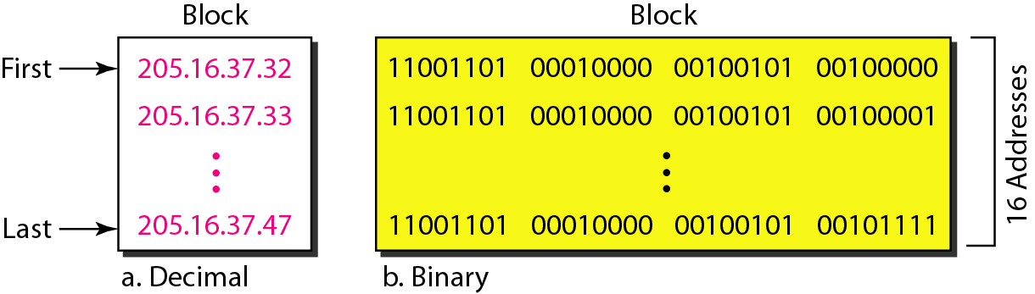
Restriction continued
This figure shows a block of addresses, in both binary and dotted-decimal notation, granted to a small business that needs 16 addresses.
We can see that the restrictions are applied to this block. The addresses are contiguous.

Slide 34
Restriction continued
The number of addresses is a power of 2 (16= 2⁴), and the first address is divisible by 16.
The first address, when converted to a decimal number, is 3,440,387,360, which when divided by 16 results in 215,024,210.

Slide 35
Classless Addressing Mask
A better way to define a block of addresses is to select any address in the block and the mask.
As we discussed before, a mask is a 32-bit number in which the n leftmost bits are 1s and the 32-n rightmost bits are 0s.
However, in classless addressing the mask for a block can take any value from 0 to 32.

Slide 36
Classless Addressing Mask continued
It is very convenient to give just the value of n preceded by a slash (CIDR – Classless Inter Domain Routing notation).
The address and the /n notation completely define the whole block (the first address, the last address, and the number of addresses).

Slide 37
1. First Address
The first address in the block can be found by setting the 32-n rightmost bits in the binary notation of the address to 0s.
Example 5: A block of addresses is granted to a small organization.
We know that one of the addresses is 205.16.37.39/28. What is the first address in the block?
Solution
The binary representation of the given address is
11001101 00010000 00100101 00100111
If we set 32−28 rightmost bits to 0, we get
11001101 00010000 00100101 00100000 or 205.16.37.32.

Slide 38
2. Last Address
The last address in the block can be found by setting the 32- n rightmost bits in the binary notation of the address to 1s.
Example 6: Find the last address for the block in Example 5.
Solution
The binary representation of the given address is
11001101 00010000 00100101 00100111
If we set 32−28 rightmost bits to 1, we get
11001101 00010000 00100101 00101111
or
205.16.37.47

Slide 39
3. Number of Addresses
The number of addresses in the block is the difference between the last and first address.
It can easily be found using the formula 2^{32-n}.
Example 7
Find the number of addresses in Example 5.
Solution
The value of n is 28, which means that number of addresses is 2 ³²⁻²⁸ or 16.

Slide 40
Number of Addresses continued
Another way to find the first address, the last address, and the number of addresses is to represent the mask as a 32-bit binary (or 8-digit hexadecimal) number.
This is particularly useful when we are writing a program to find these pieces of information. In the above example the /28 can be represented as
11111111 11111111 11111111 11110000
(twenty-eight 1s and four 0s). Find
a. The first address
b. The last address
c. The number of addresses.

Slide 41
Solution
The first address can be found by ANDing the given addresses with the mask.
ANDing here is done bit by bit.
The result of ANDing 2 bits is 1 if both bits are 1s; the result is 0 otherwise.

Slide 42
b. The last address can be found by ORing the given addresses with the complement of the mask.
Oring here is done bit by bit.
The result of ORing 2 bits is 0 if both bits are 0s; the result is 1 otherwise.
The complement of a number is found by changing each 1 to 0 and each 0 to 1.

Slide 43
c. The number of addresses can be found by complementing the mask, interpreting it as a decimal number, and adding 1 to it.

Slide 44
Network Addresses
A very important concept in IP addressing is the network address.
When an organization is given a block of addresses, the organization is free to allocate the addresses to the devices that need to be connected to the Internet.
The first address in the class, however, is normally (not always) treated as a special address.
The first address is called the network address and defines the organization network.
It defines the organization itself to the rest of the world.
The first address is the one that is used by routers to direct the message sent to the organization from the outside.

Slide 45
Hierarchy
IP addresses, like other addresses or identifiers we encounter these days, have levels of hierarchy.
For example, a telephone network in Ethiopia has three levels of hierarchy.
The leftmost three digits (251) define the country code, the next three digits (011, for example) define the area, the last seven digits (1112343, for example) define the subscriber number.

Slide 46
Two-Level Hierarchy: No Subnetting
An IP address can define only two levels of hierarchy when not subnetted.
The n leftmost bits of the address x.y.z.t/n define the network (organization network); the 32 – n rightmost bits define the particular host (computer or router) to the network.
The two common terms are prefix and suffix.
The part of the address that defines the network is called the prefix; the part that defines the host is called the suffix.
The prefix is common to all addresses in the network; the suffix changes from one device to another.

Slide 47
Three-Levels of Hierarchy: Subnetting
An organization that is granted a large block of addresses may want to create clusters of networks (called subnets) and divide the addresses between the different subnets.
The rest of the world still sees the organization as one entity; however, internally there are several subnets.
All messages are sent to the router address that connects the organization to the rest of the Internet; the router routes the message to the appropriate subnets.
The organization, however, needs to create small sub blocks of addresses, each assigned to specific subnets.
The organization has its own mask; each subnet must also have its own.

Slide 48
Example 7
Suppose an organization is given the block 17.12.14.0/26, which contains 64 addresses.
The organization has three offices and needs to divide the addresses into three sub blocks of 32, 16, and 16 addresses.
We can find the new masks by using the following arguments:
Suppose the mask for the first subnet is n1, then 2^{32-n1} must be 32, which means that n1 = 27.
Suppose the mask for the second subnet is n2, then 2^{32-n2} must be 16, which means that n2 = 28.
Suppose the mask for the third subnet is n3, then 2^{32-n3} must be 16, which means that n3 = 28.
This means that we have the masks 27, 28, 28 with the organization mask being 26.

Slide 49
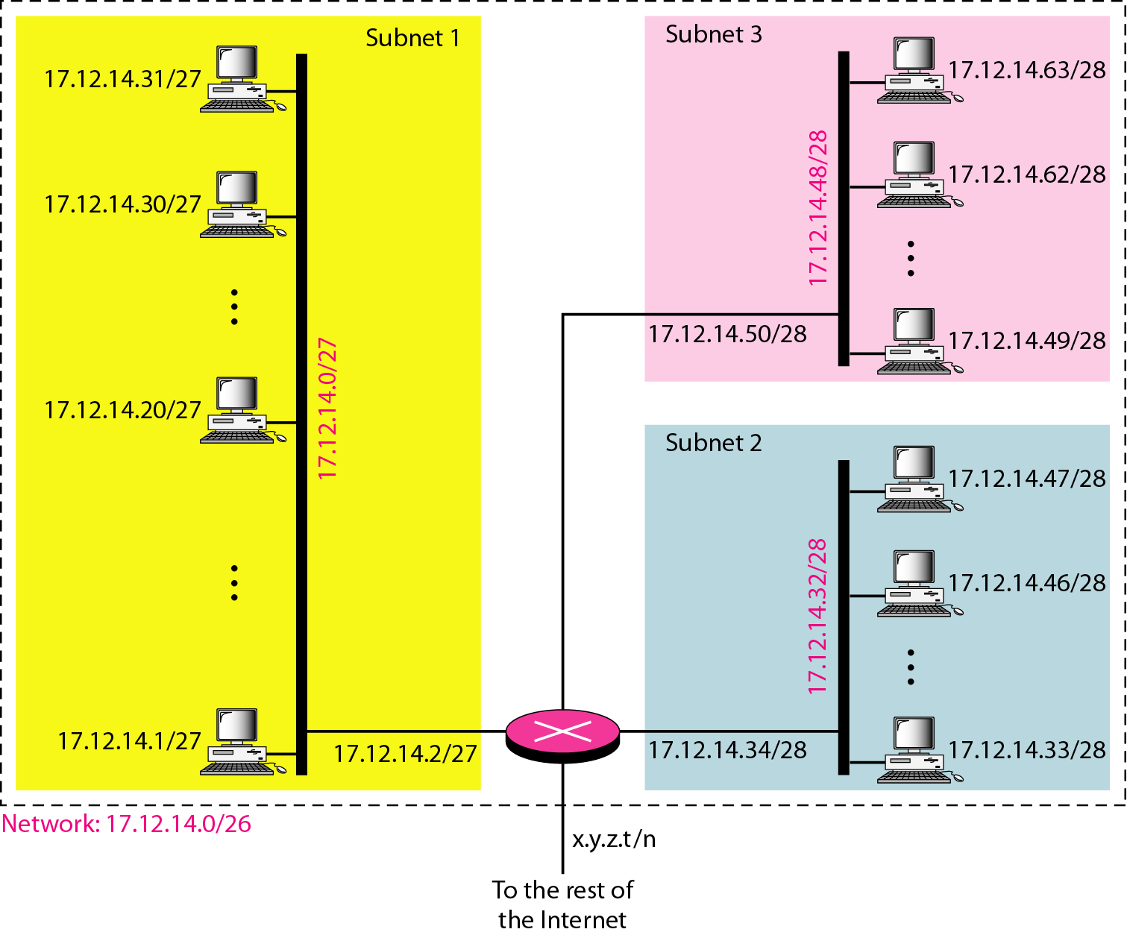

Slide 50
More Levels of Hierarchy
The structure of classless addressing does not restrict the number of hierarchical levels.
An organization can divide the granted block of addresses into sub blocks.
Each sub block can in turn be divided into smaller sub blocks. And so on.
One example of this is seen in the ISPs. A national ISP can divide a granted large block into smaller blocks and assign each of them to a regional ISP. A regional ISP can divide the block received from the national ISP into smaller blocks and assign each one to a local ISP.
A local ISP can divide the block received from the regional ISP into smaller blocks and assign each one to a different organization.
Finally, an organization can divide the received block and make several subnets out of it.

Slide 51
Address Allocation
The next issue in classless addressing is address allocation. How are the blocks allocated?
The ultimate responsibility of address allocation is given to a global authority called the Internet Corporation for Assigned Names and Addresses (ICANN).
However, ICANN does not normally allocate addresses to individual organizations. It assigns a large block of addresses to an ISP.
Each ISP, in turn, divides its assigned block into smaller sub blocks and grants the sub blocks to its customers.
In other words, an ISP receives one large block to be distributed to its Internet users. This is called address aggregation: many blocks of addresses are aggregated in one block and granted to one ISP.

Slide 52
Example 8
An ISP is granted a block of addresses starting with 190.100.0.0/16 (65,536 addresses). The ISP needs to distribute these addresses to three groups of customers as follows:
a. The first group has 64 customers; each needs 256 addresses.
b. The second group has 128 customers; each needs 128 addresses.
c. The third group has 128 customers; each needs 64 addresses.
Design the sub blocks and find out how many addresses are still available after these allocations.

Slide 53
solution
Group 1: For this group, each customer needs 256 addresses. This means that 8 bits are needed to define each host. The prefix length is then 32 − 8 = 24. The addresses are
Group 2: For this group, each customer needs 128 addresses. This means that 7 bits are needed to define each host. The prefix length is then 32 − 7 = 25. The addresses are

Slide 54
Contd.
Group 3: For this group, each customer needs 64 addresses. This means that 6 bits are needed to each host. The prefix length is then 32 − 6 = 26. The addresses are
Number of granted addresses to the ISP: 65,536
Number of allocated addresses by the ISP: 40,960
Number of available addresses: 24,576

Slide 55
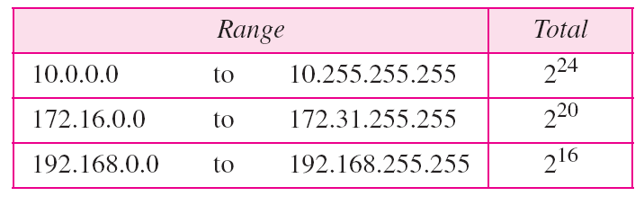
Network Address Translation (NAT)
Many users start to have more hosts to be connected to the internet
IP addresses are in depletion
Solution: NAT
NAT enables a user to have a large set of addresses internally and one address, or a small set of addresses, externally.
The traffic inside can use the large set; the traffic outside, the small set.

Slide 56
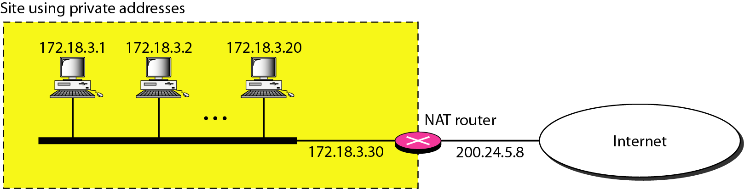
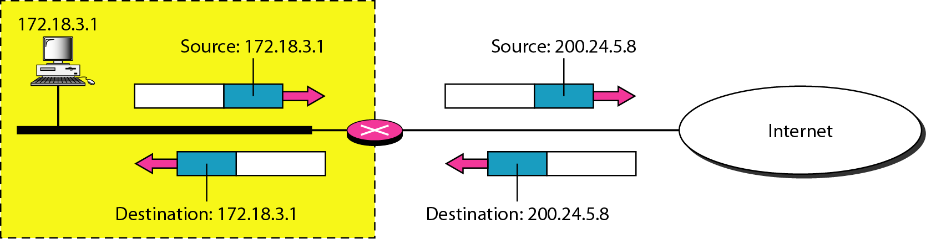

Slide 57
Reading Assignment:
Read how NAT works
Investigate the global IP address scheme of Adama University and how they used it in NAT

Slide 58
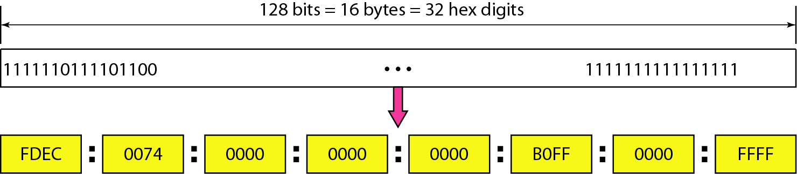
IPv6 ADDRESSES
Despite all short-term solutions, address depletion is still a long-term problem for the Internet.
This and other problems in the IP protocol itself have been the motivation for IPv6.
An IPv6 address is 128 bits or 32 hexadecimal digits long.

Slide 59
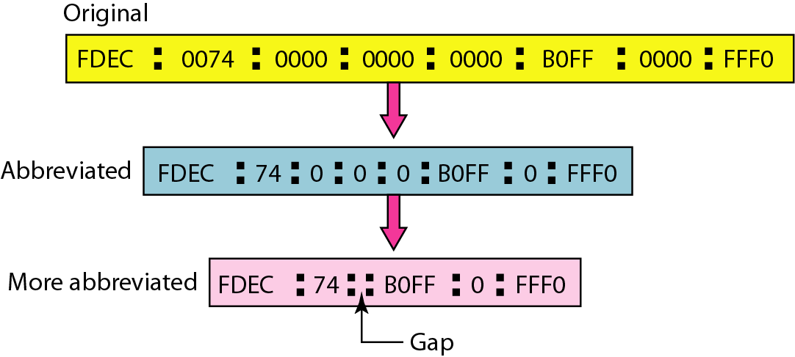
Abbreviated IPv6 addresses

Slide 60
Example 9
Expand the address 0:15::1:12:1213 to its original.
Solution
We first need to align the left side of the double colon to the left of the original pattern and the right side of the double colon to the right of the original pattern to find how many 0s we need to replace the double colon.
This means that the original address is.

Slide 61
ADDRESS MAPPING
The delivery of a packet to a host or a router requires two levels of addressing:
logical and physical.
We need to be able to map a logical address to its corresponding physical address and vice versa.
This can be done by using either static or dynamic mapping.
IP is used for logical addressing
MAC is used for physical addressing in a local network such as Ethernet

Slide 62
Mapping Logical to Physical Address: ARP
Anytime a host or a router has an IP datagram to send to another host or router, it has the logical (IP) address of the receiver.
The logical (IP) address is obtained from the DNS if the sender is the host or it is found in a routing table if the sender is a router.
But the IP datagram must be encapsulated in a frame to be able to pass through the physical network.

Slide 63
Mapping Logical to Physical Address: ARP-------
This means that the sender needs the physical address of the receiver. The host or the router sends an ARP query packet.
The packet includes the physical and IP addresses of the sender and the IP address of the receiver.
Because the sender does not know the physical address of the receiver, the query is broadcast over the network

Slide 64
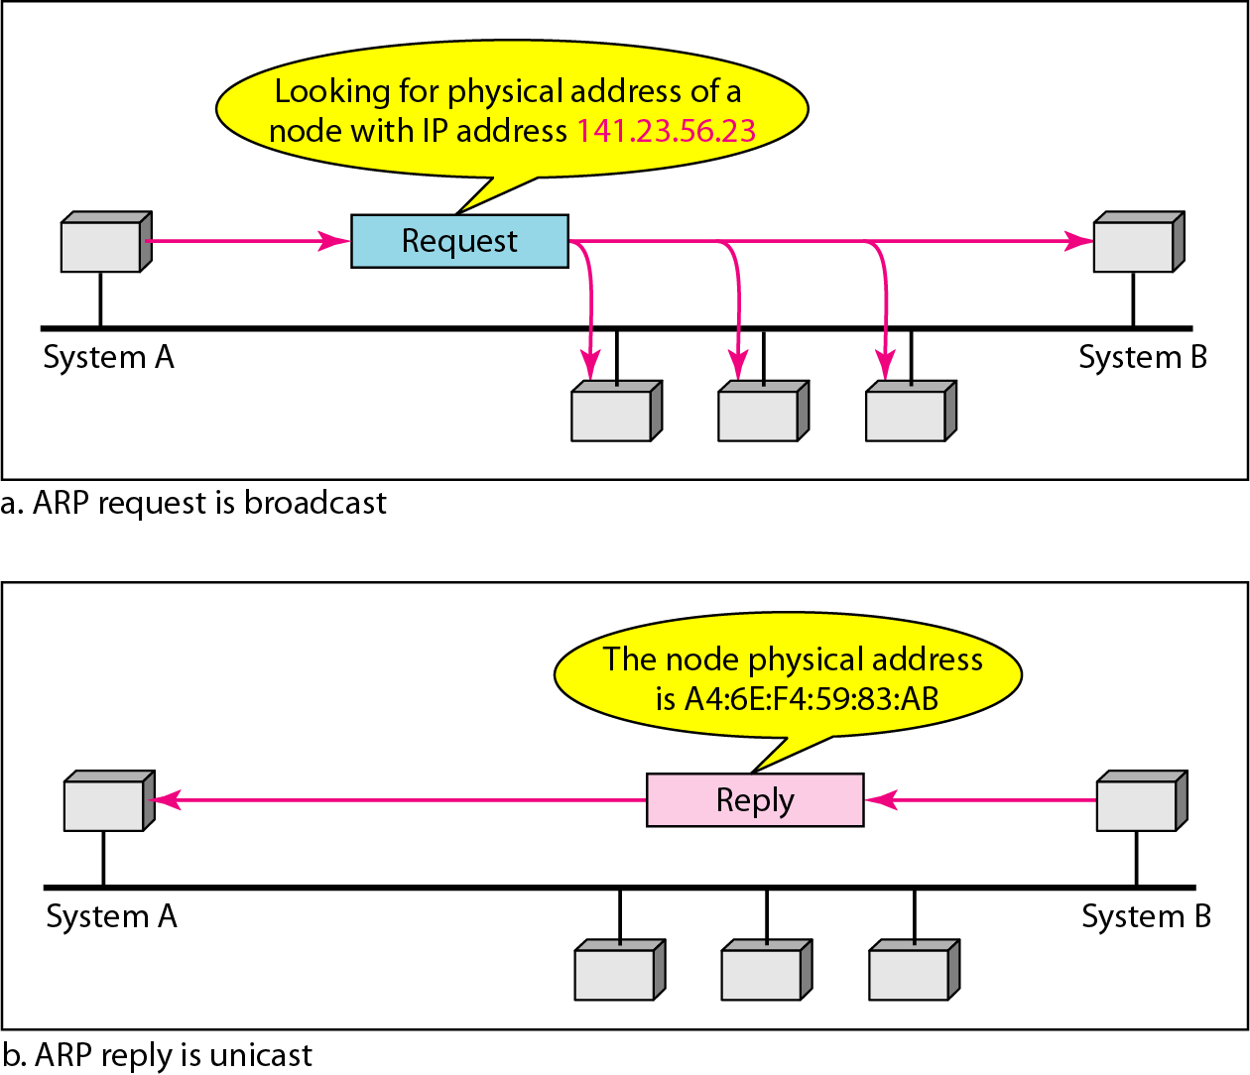

Slide 65
Mapping Physical to Logical Address: RARP
There are occasions in which a host knows its physical address, but needs to know its logical address.
This may happen in two cases:
A diskless station is just booted.
The station can find its physical address by checking its interface, but it does not know its IP address.
2. An organization does not have enough IP addresses to assign to each station; it needs to assign IP addresses on demand.
The station can send its physical address and ask for a short time lease.

Slide 66
RARP--------------------
Reverse Address Resolution Protocol (RARP) finds the logical address for a machine that knows only its physical address.
Each host or router is assigned one or more logical (IP) addresses, which are unique and independent of the physical (hardware) address of the machine.
To create an IP datagram, a host or a router needs to know its own IP address or addresses.
The IP address of a machine is usually read from its configuration file stored on a disk file.

Slide 67
RARP--------------------
The machine can get its physical address (by reading its NIC, for example), which is unique locally.
It can then use the physical address to get the logical address by using the RARP protocol.
A RARP request is created and broadcast on the local network.
Another machine on the local network that knows all the IP addresses will respond with a RARP reply.

Slide 68
ICMP
The IP protocol has no error-reporting or error-correcting mechanism.
The IP protocol also lacks a mechanism for host and management queries.
The Internet Control Message Protocol (ICMP) has been designed to compensate for the above two deficiencies.
It is a companion to the IP protocol.
PING and TRACEROUTE are two tools for ICMP

